Slide 1
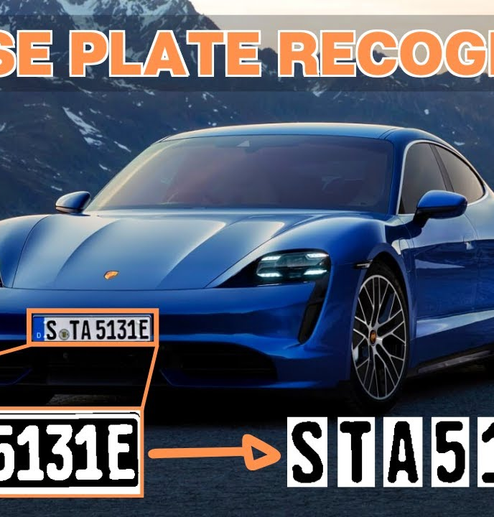
AUTOMATIC LICENSE NUMBER PLATE DETECTION AND RECOGNITION

Slide 2
AUTOMATIC LICENSE NUMBER PLATE DETECTION AND RECOGNITION

Slide 3


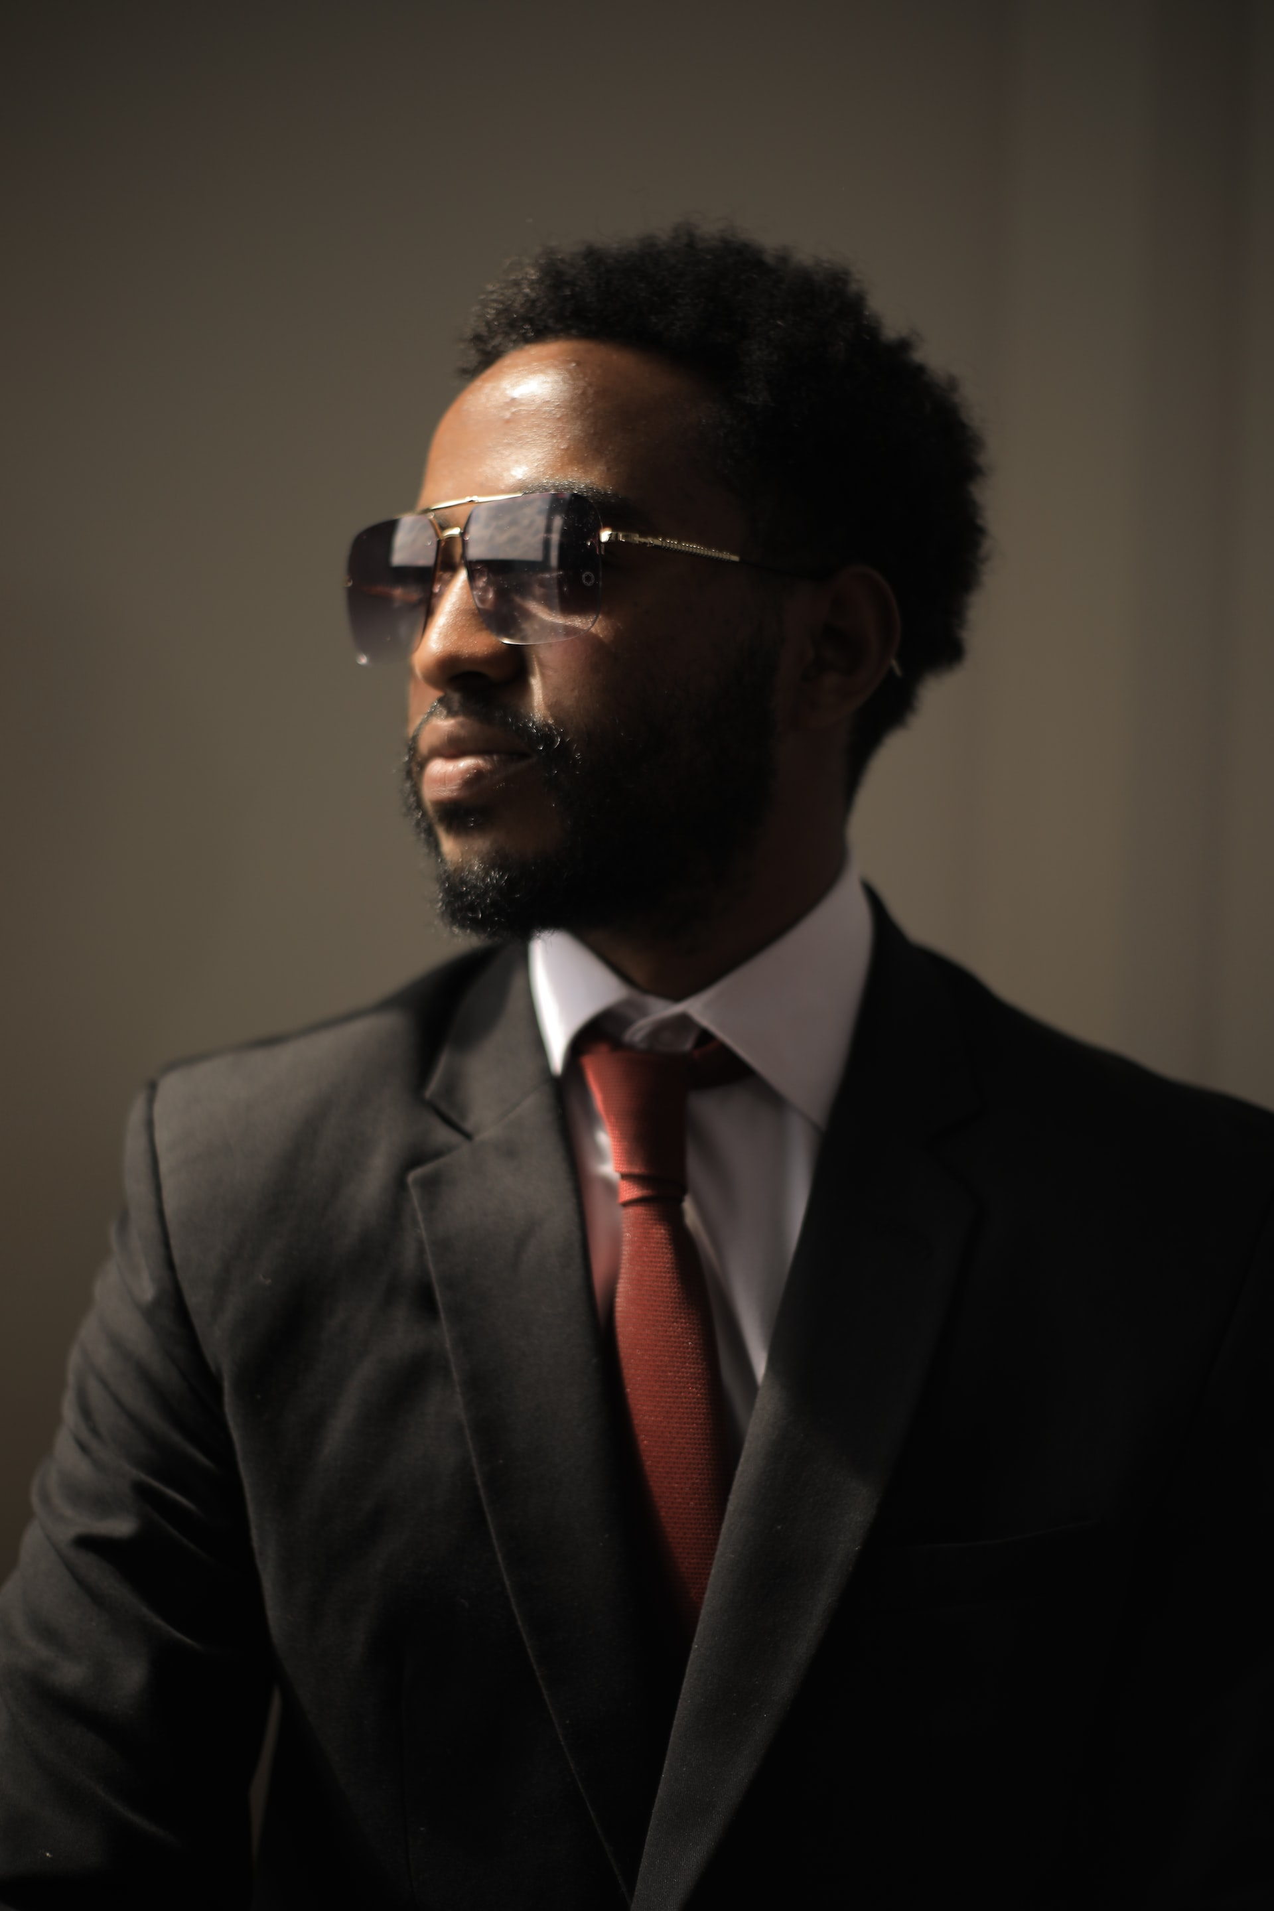


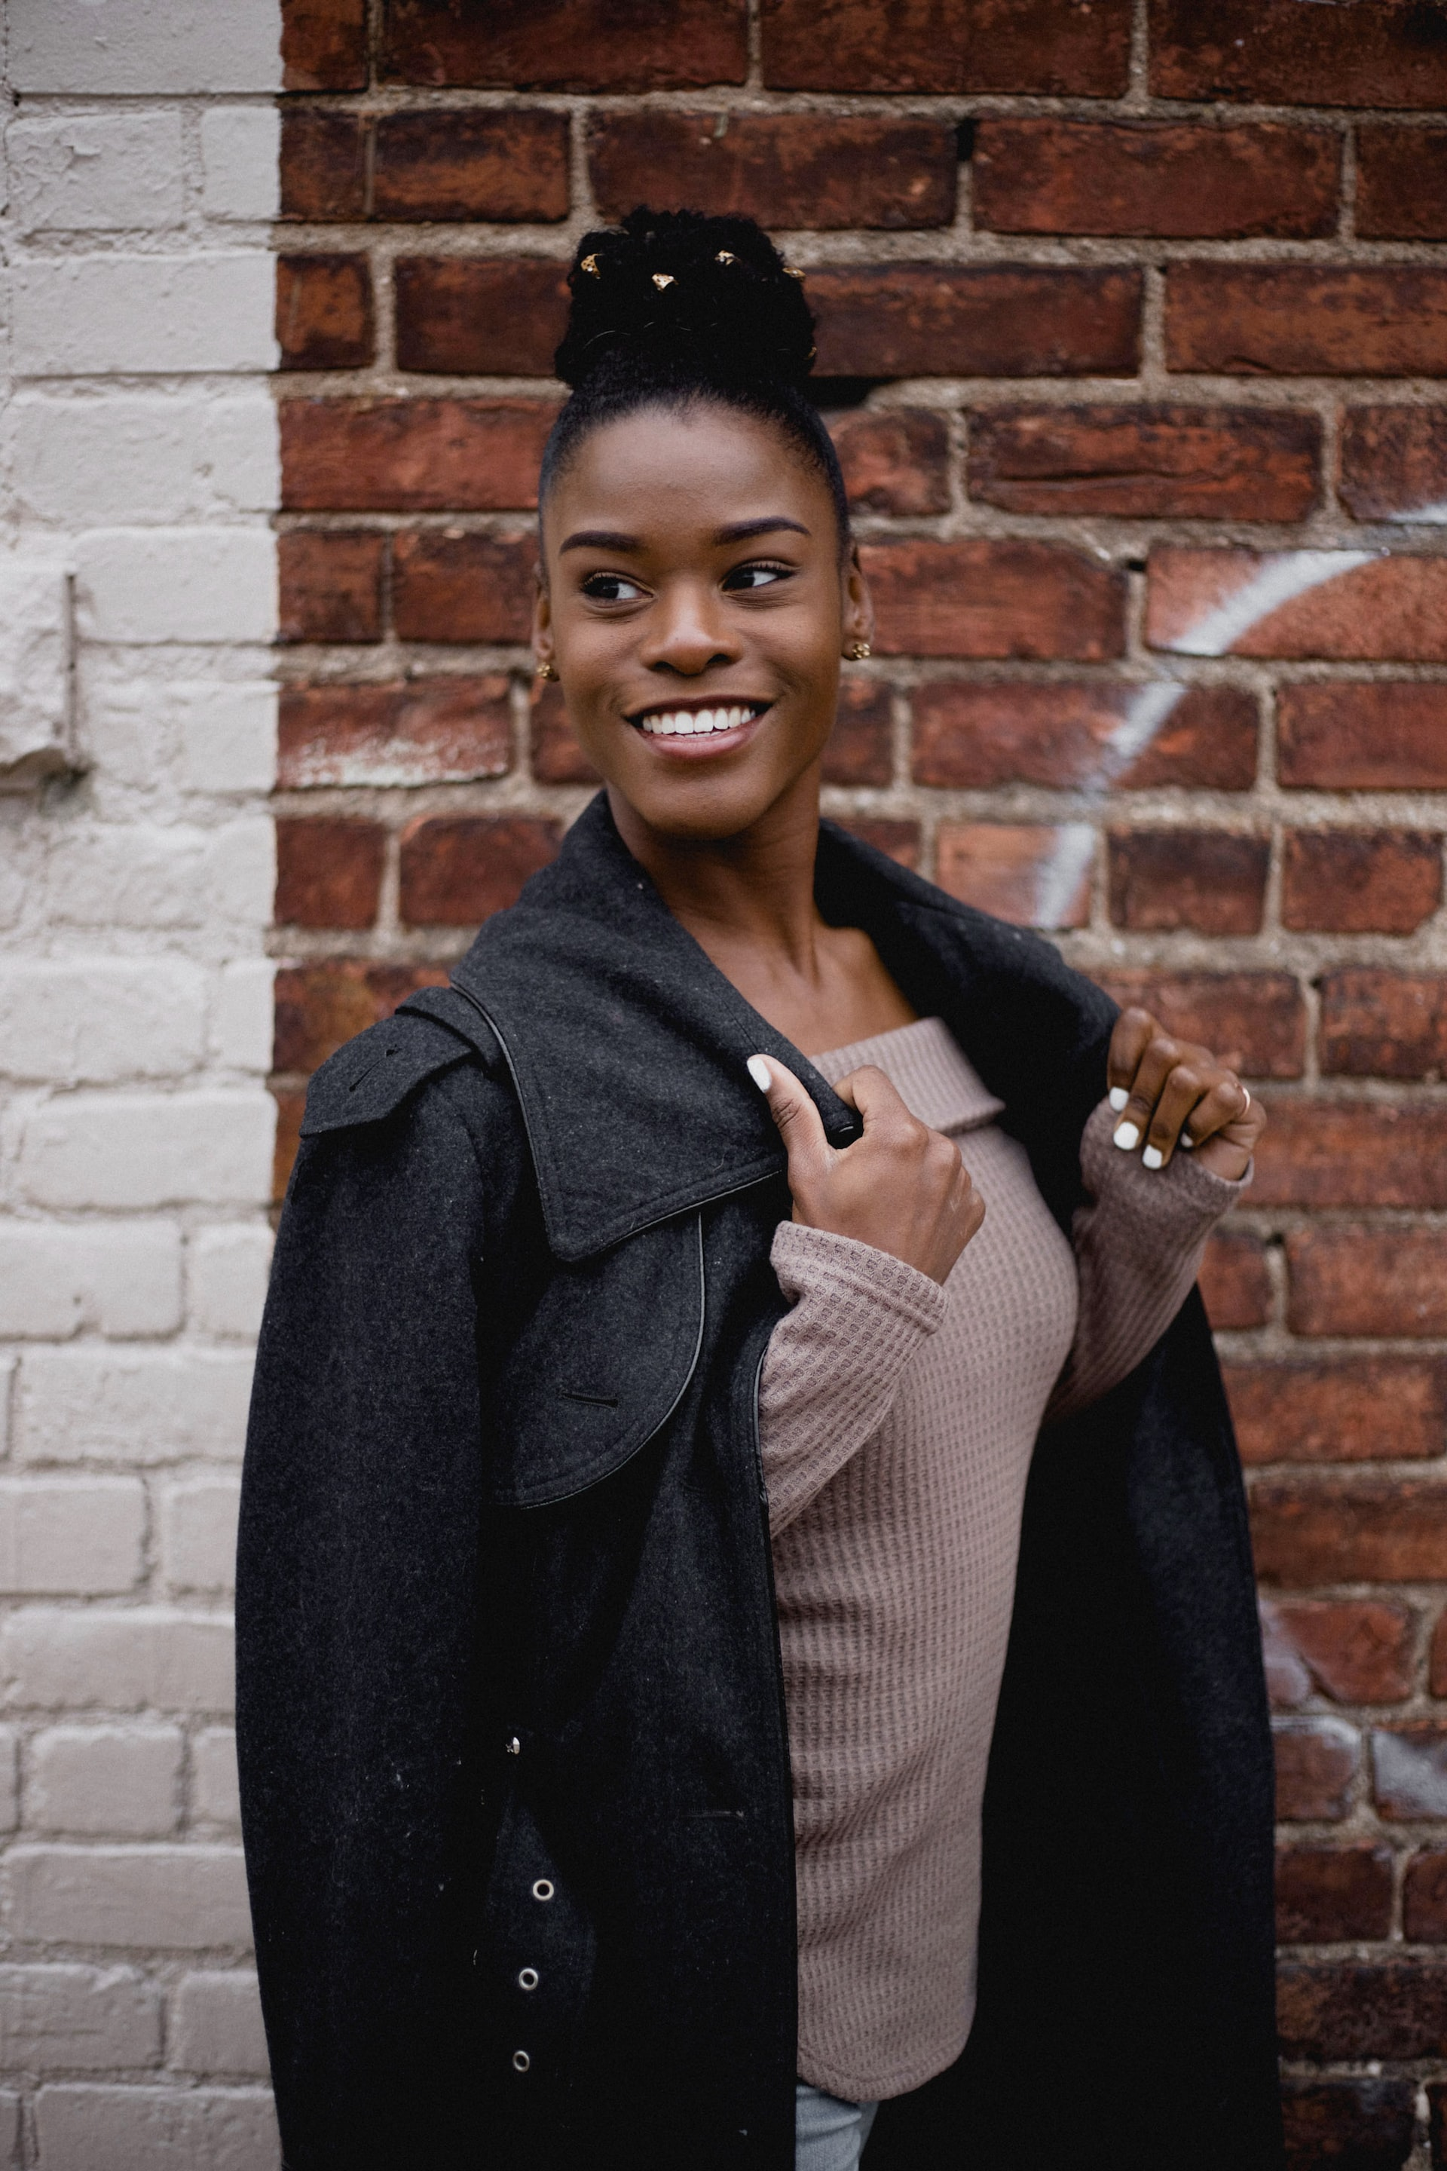
ALAN RAY
RONALD WATKINS
MEET THE TEAM
CHIEF COMPLIANCE OFFICER
CHIEF FINANCIAL OFFICER
RUBY READ
CHIEF EXECUTIVE OFFICER
GREG BADMAN
PEARL SNYDER
EVA PORTER
CHIEF OPERATING OFFICER
CHIEF TECHNOLOGY OFFICER
CHIEF DATA OFFICER

Slide 4






MEET THE TEAM
Phan Nguyễn Gia Huy
Phạm Hoàng Hải Đăng
Nguyễn Đỗ Bảo Kiên
Trần Đình Tấn Phát
Lê Hồng Thạch
Nguyễn Đức Tài

Slide 5
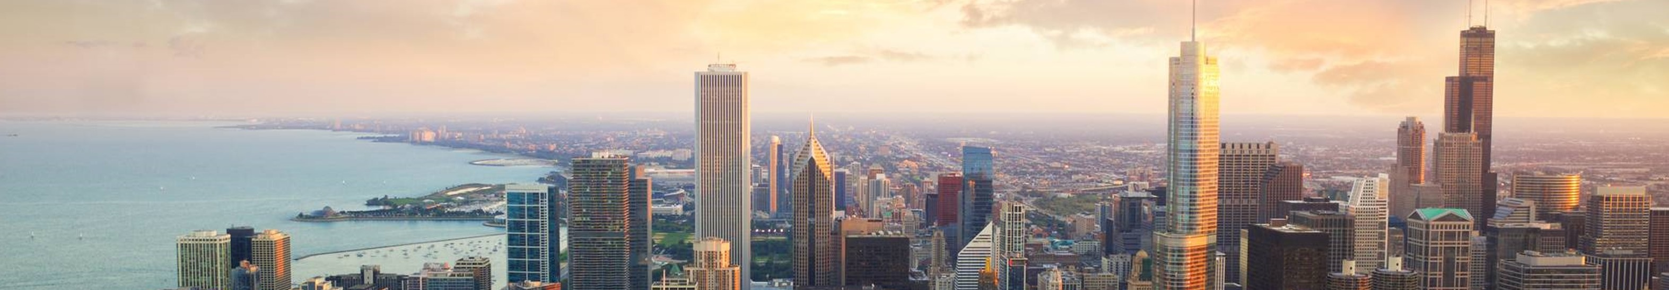
Table of content

Slide 6
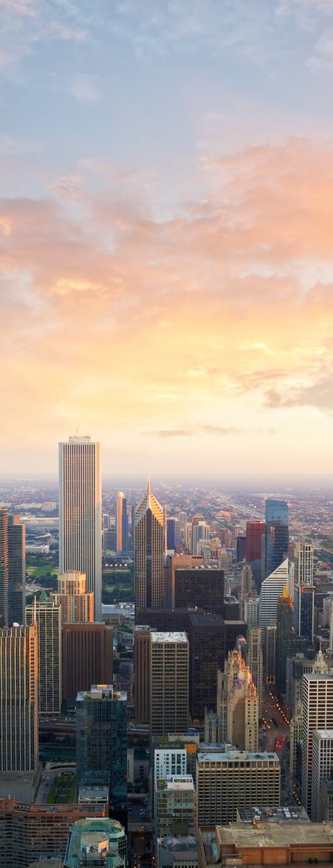
Introduction
Labeling
Data processing
Deep learning for object detection
Pipeline object detection model
Optical Character Recognition - OCR
Number plate web app
Real time plate recognition with yolo
conclusion

Slide 7
AGENDA
Introduction
Labeling
Data processing
Deep learning for object detection
Pipeline object detection model
Optical Character Recognition - OCR
Number plate web app
Real time plate recognition with yolo
conclusion

Slide 8
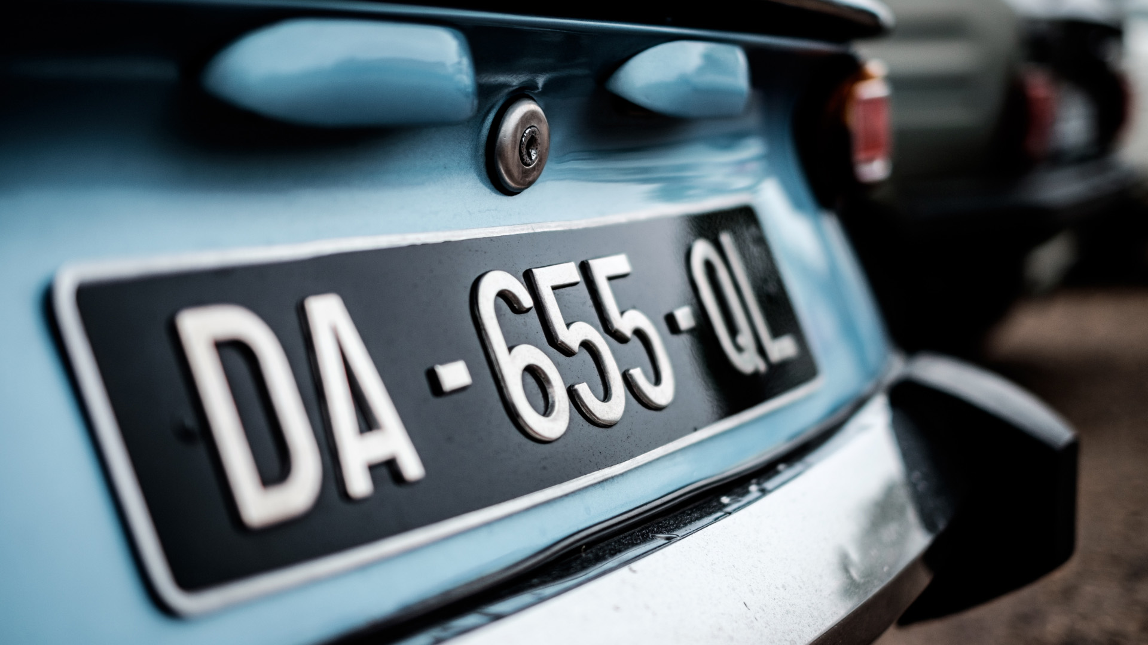
Introduction
Introduce about number plate recognition in real life

Slide 9
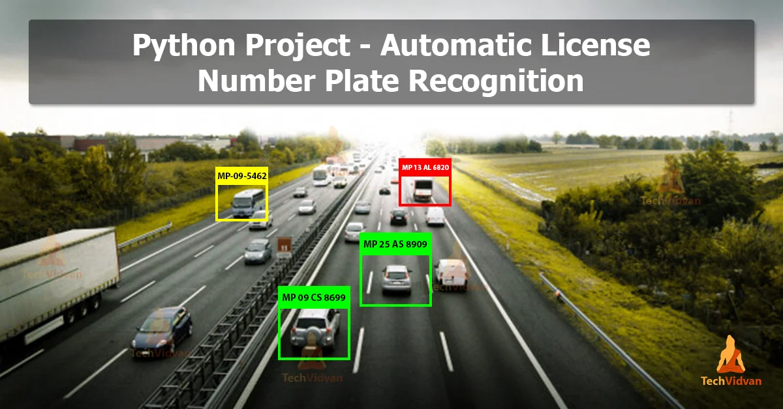

Slide 10
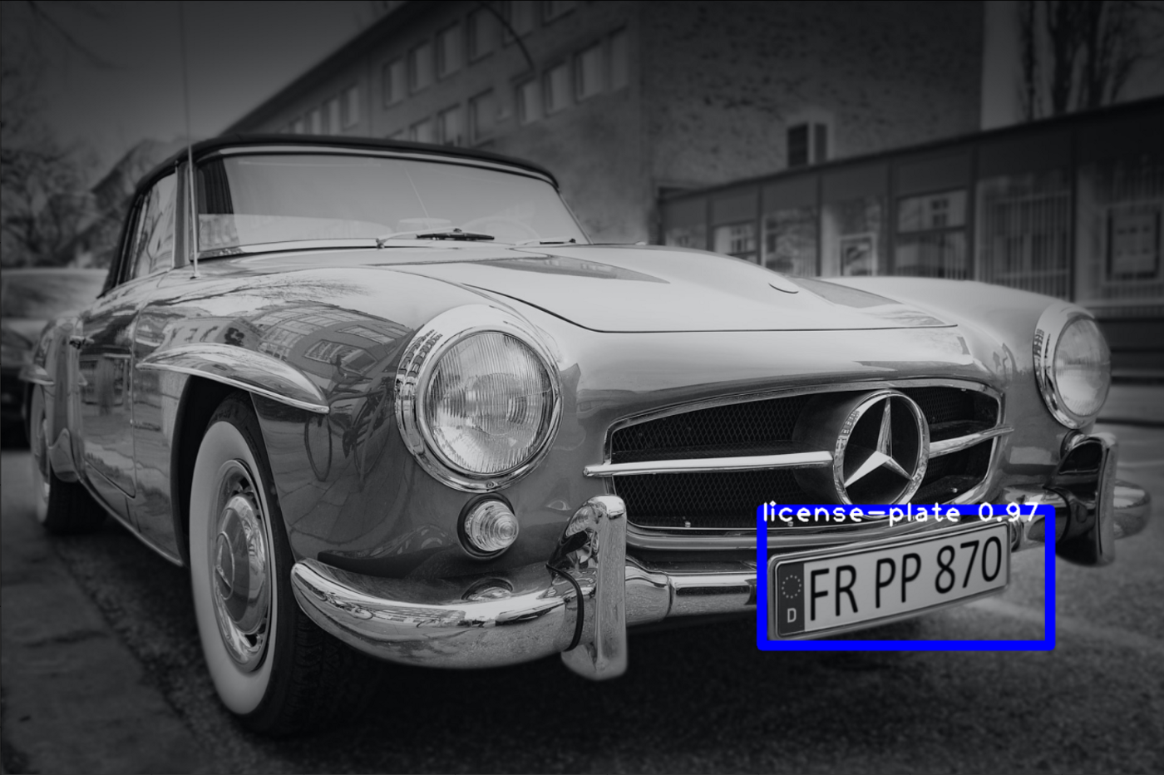

Slide 11
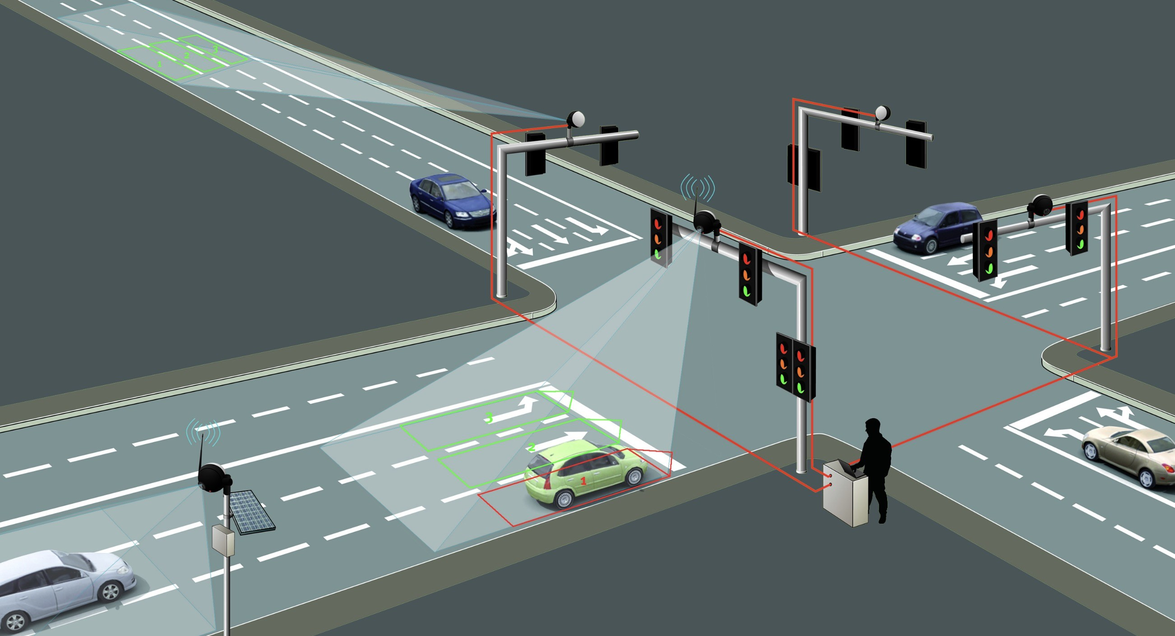
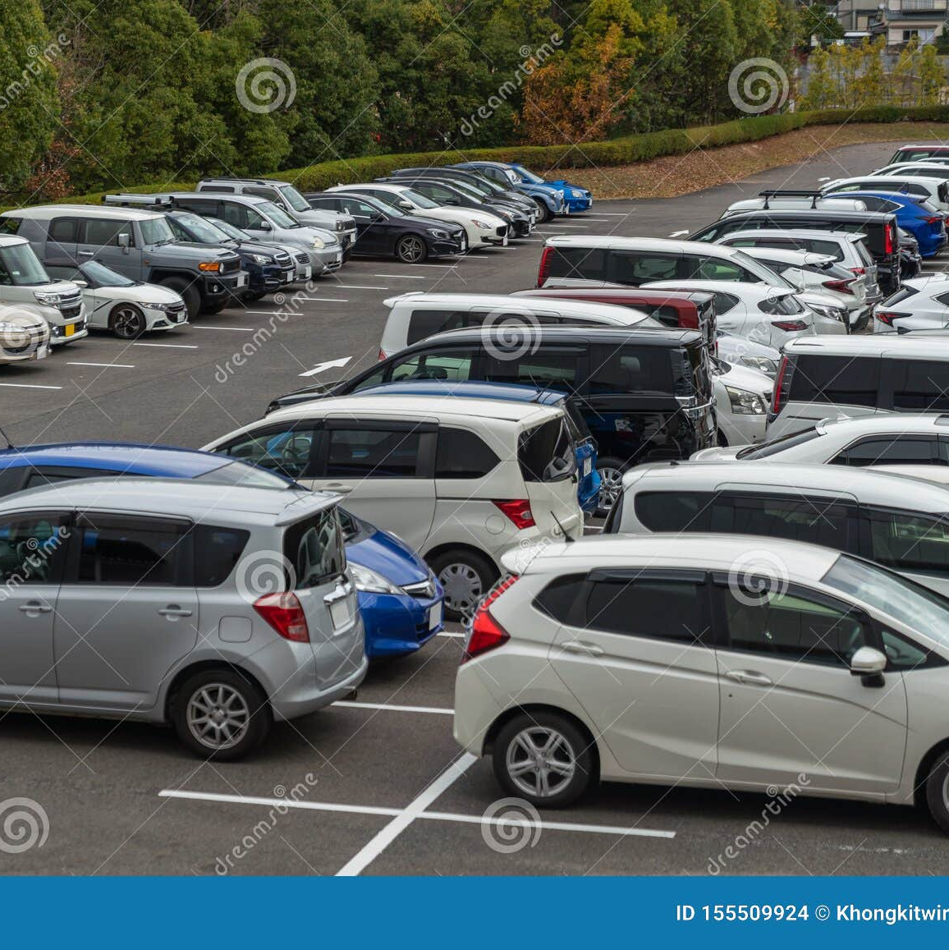
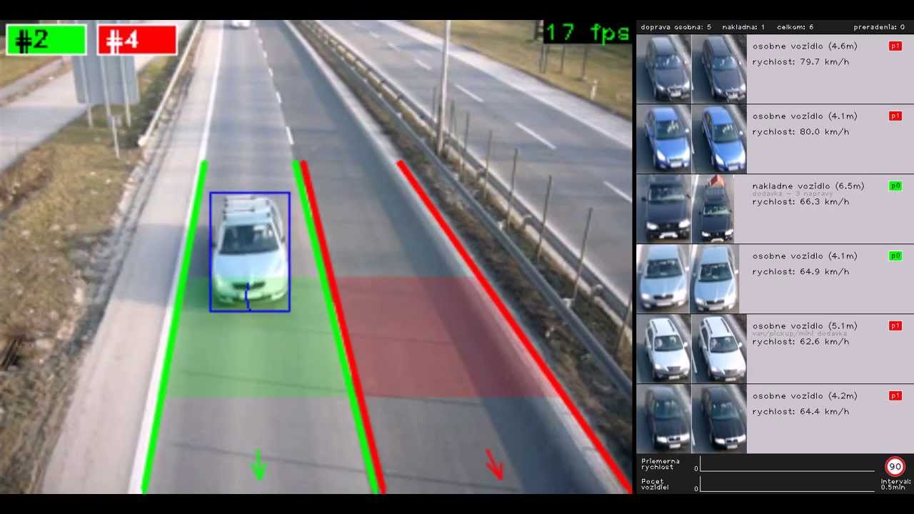
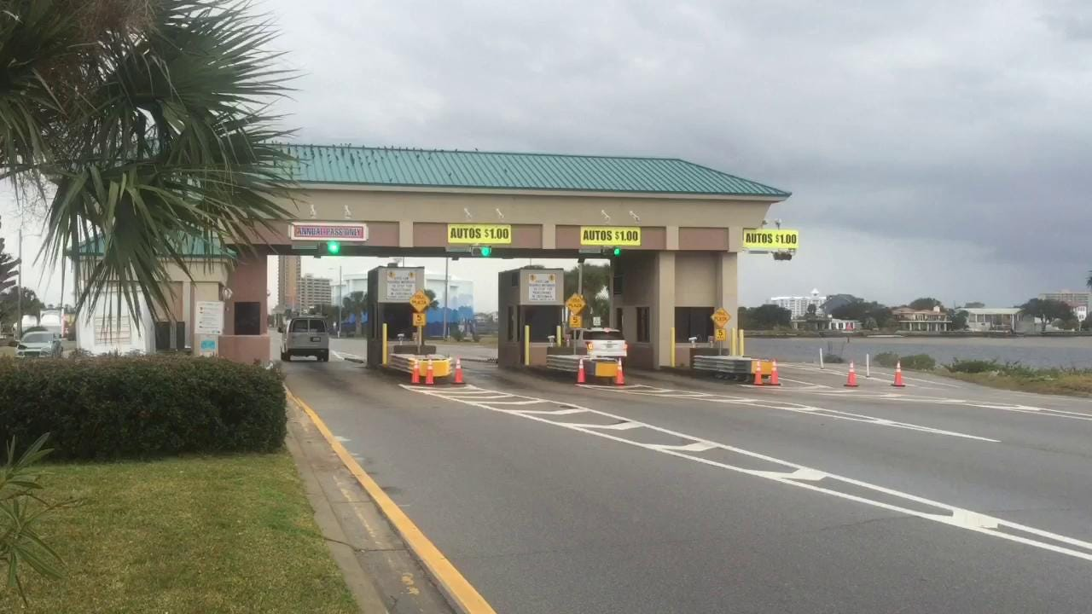
Toll enforcement
Traffic control
Vehicle surveillance
parking

Slide 12
Vehicle surveillance
Traffic control
parking
Toll enforcement

Slide 13
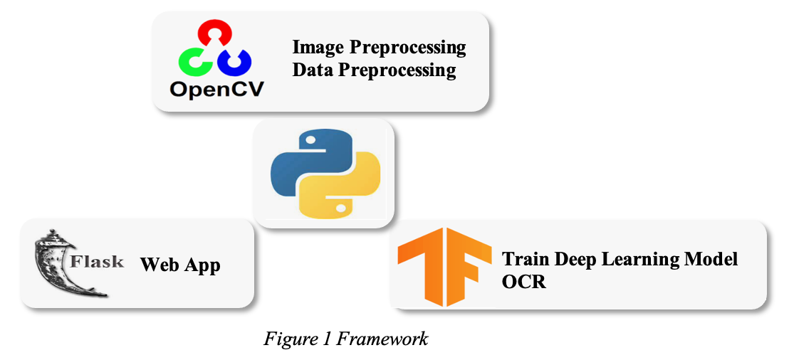

Slide 14
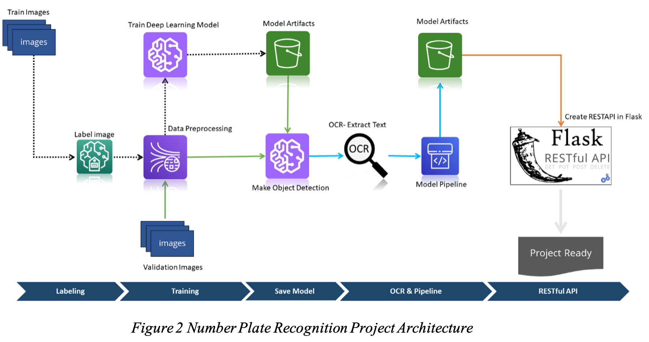

Slide 15
LaBeling

Slide 16
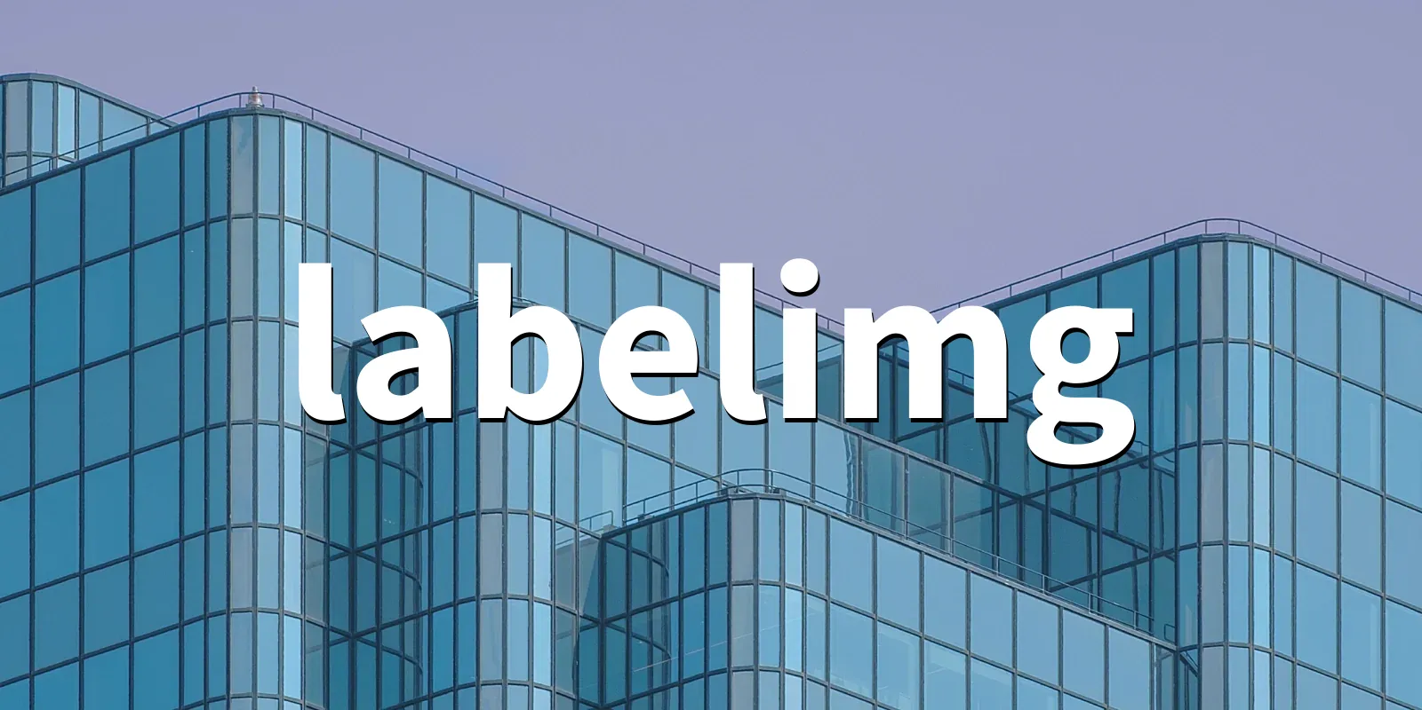

Slide 17
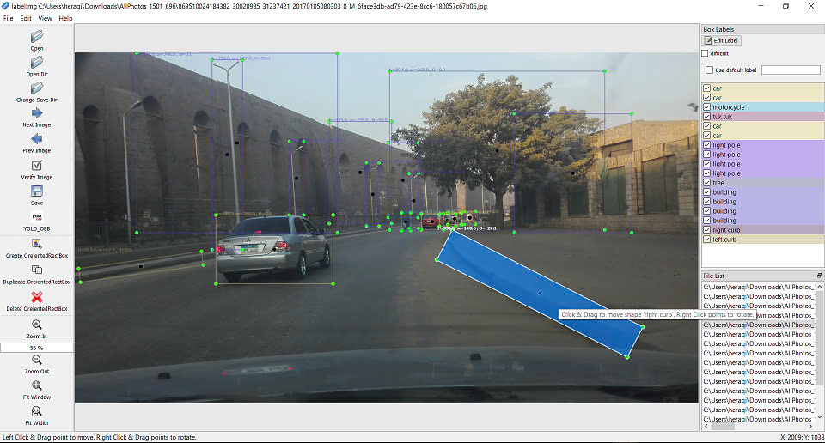

Slide 18
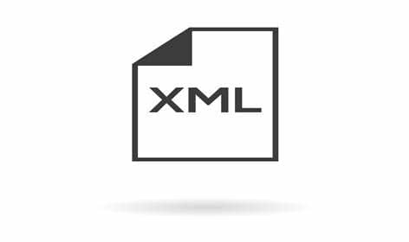

Slide 19
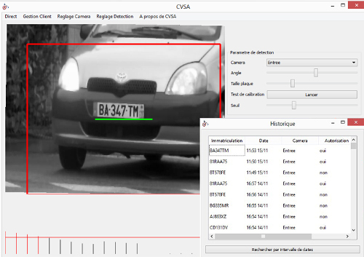

Slide 20
Data processing

Slide 21
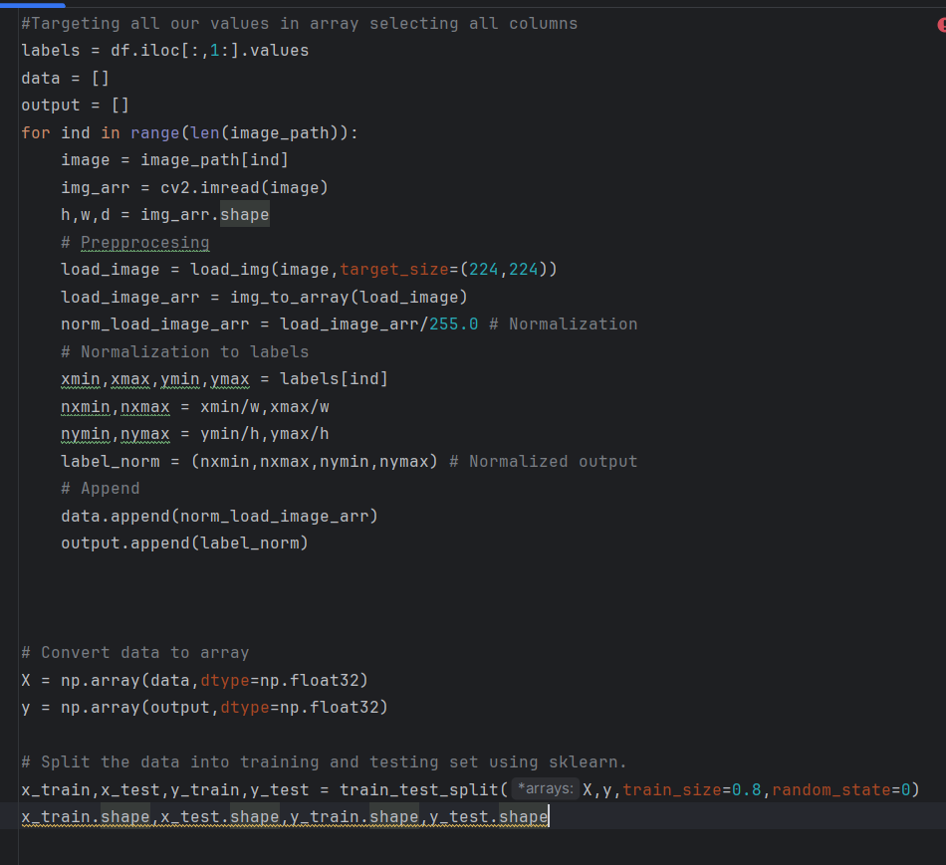

Slide 22
4. DEEP LEARNING FOR OBJECT DETECTION

Slide 23
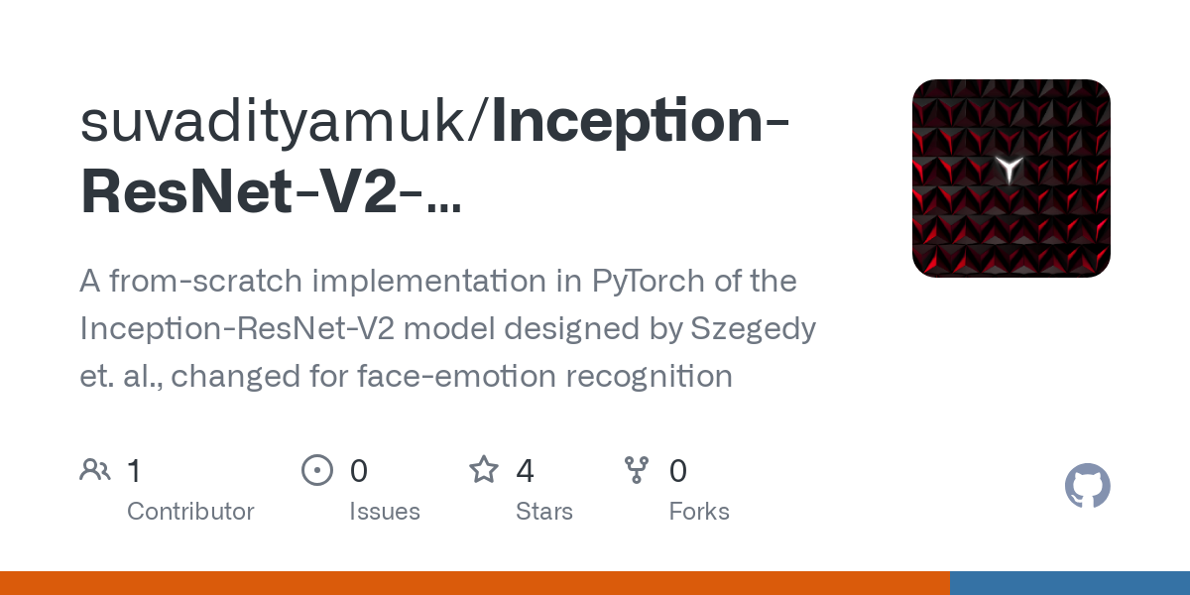

Slide 24
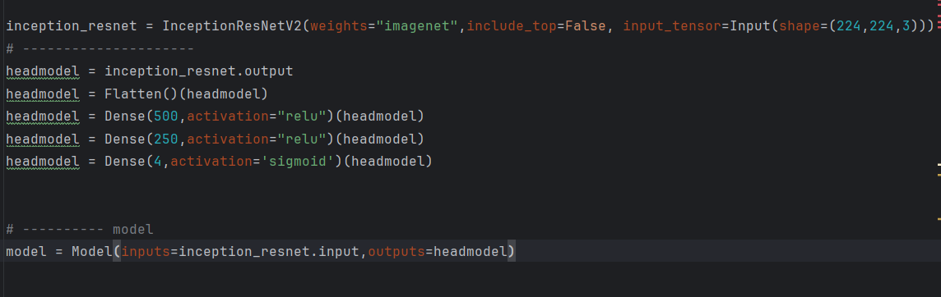

Slide 25
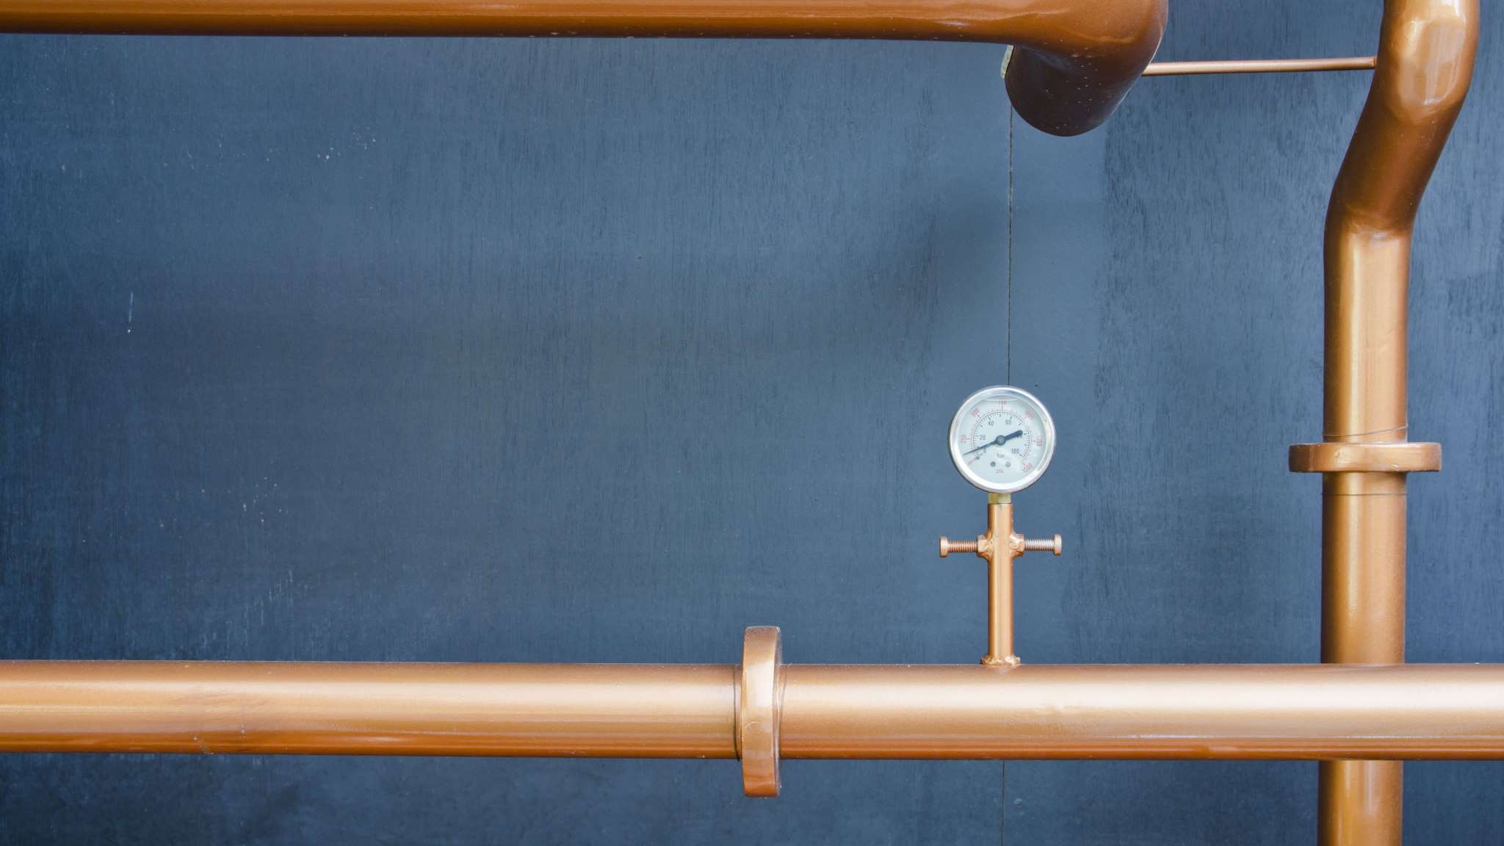
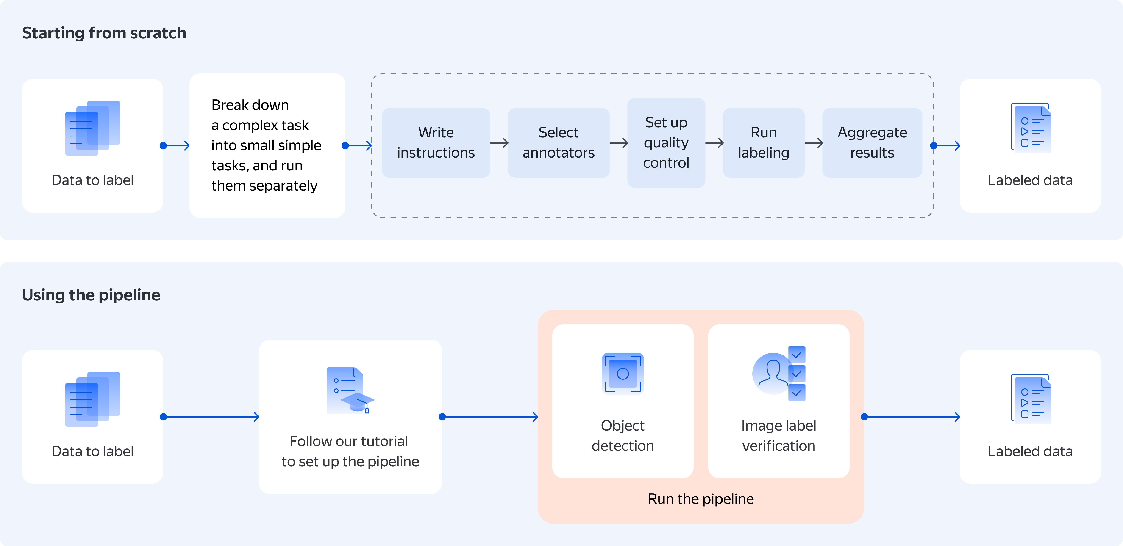
5. PIPELINE OBJECT DETECTION MODEL

Slide 26
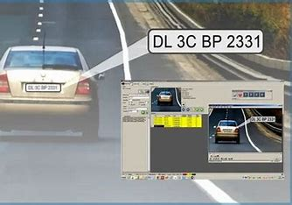
5.1 MAKE PREDICTIONS

Slide 27
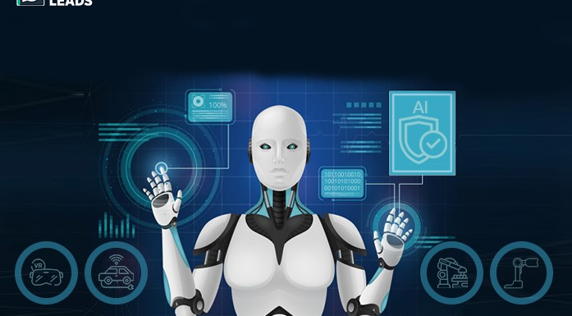

Slide 28

5.2 DE-NORMALIZE THE OUTPUT

Slide 29
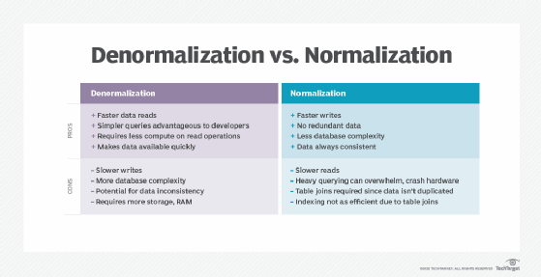

Slide 30
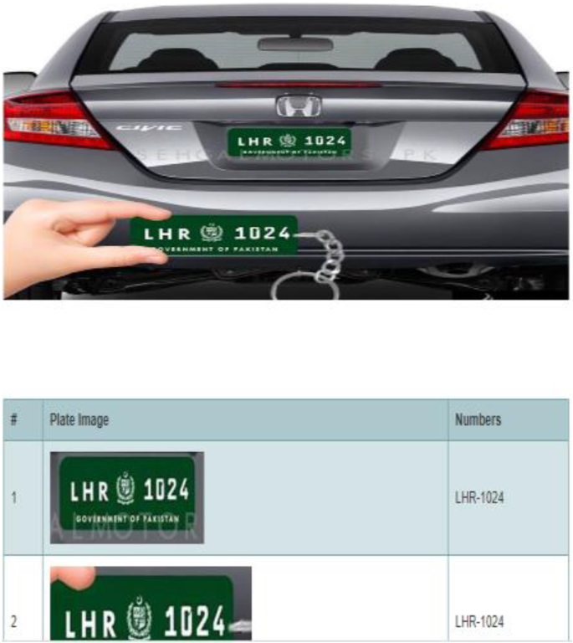
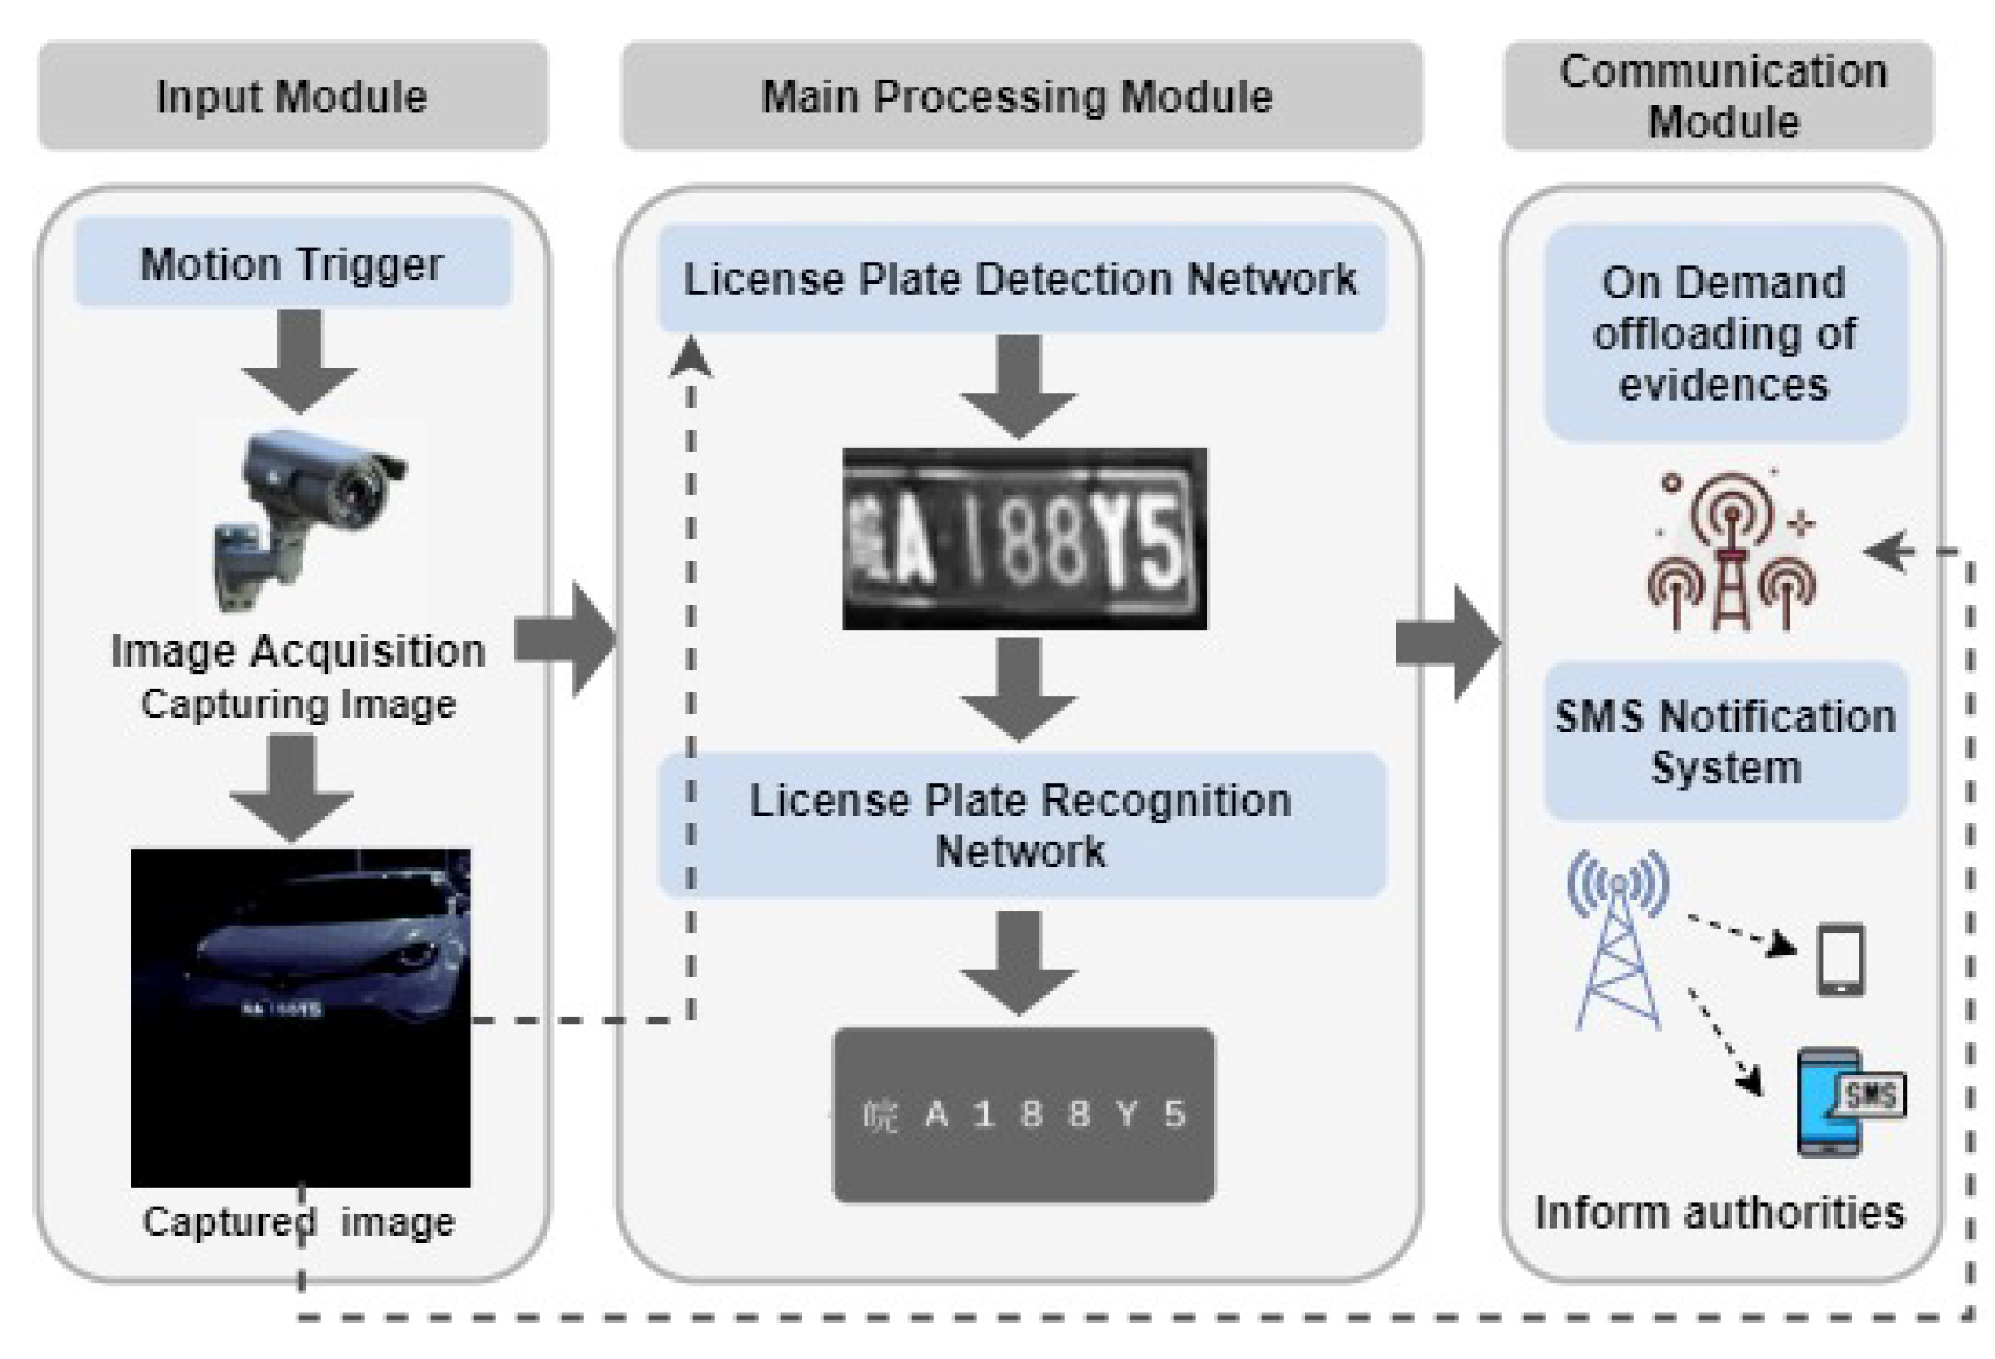

Slide 31
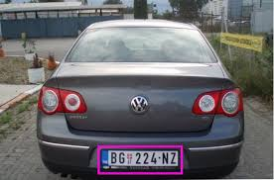
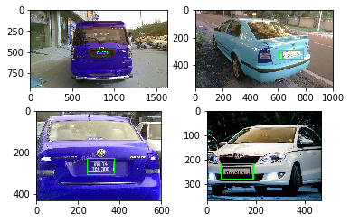
5.3 BOUNDING BOX

Slide 32

5.4 CREATE PIPELINE

Slide 33
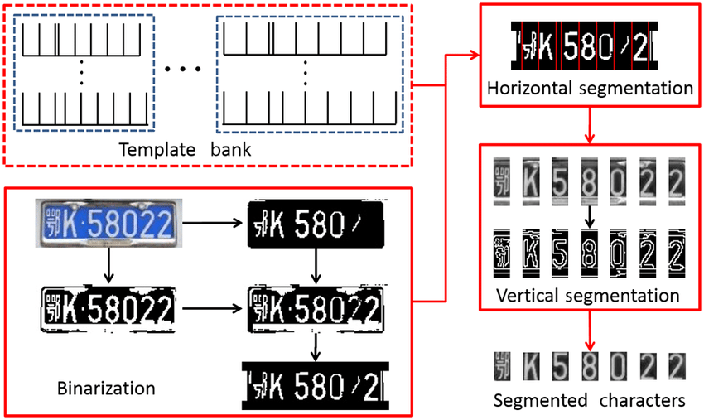

Slide 34
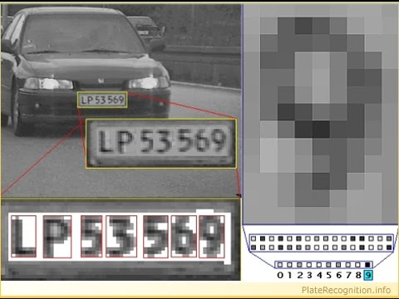
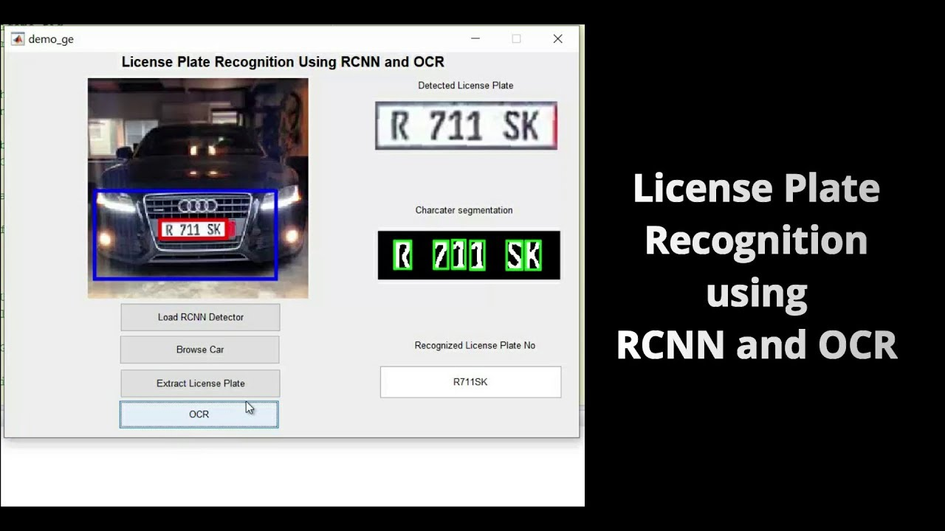
6. OPTICAL CHARACTER RECOGNITION - OCR

Slide 35



6.1 TESSERACT OCR

Slide 36
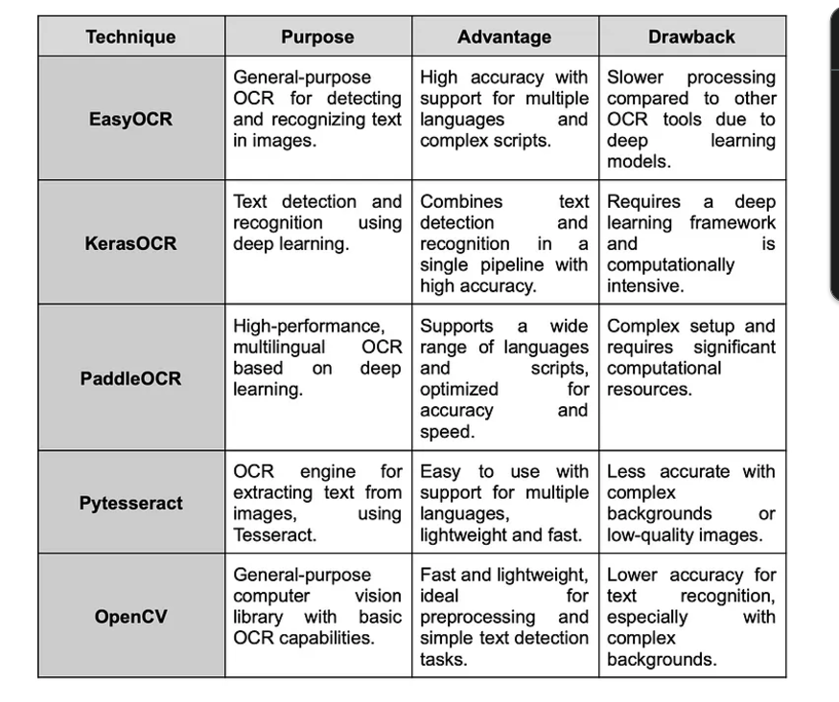
6.2 LIMITATIONS OF PYTESSERACT
The OCR is not as accurate as some commercial solutions available to us.
Doesn't do well with images affected by artifacts including partial occlusion, distorted perspective, and complex background.
It is not capable of recognizing handwriting.
It may find gibberish and report this as OCR output.
If a document contains languages outside of those given in the -l LANG arguments, results may be poor.
It is not always good at analyzing the natural reading order of documents. For example, it may fail to recognize that a document contains two columns, and may try to join text across columns.
Poor quality scans may produce poor quality OCR.
It does not expose information about what font family text belongs to.

Slide 37
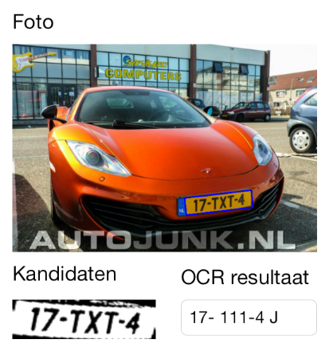
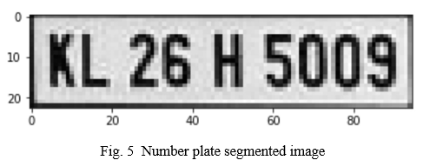
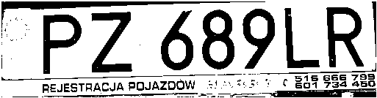
6.3 EXTRACT NUMBER PLATE TEXT FROM IMAGE

Slide 38
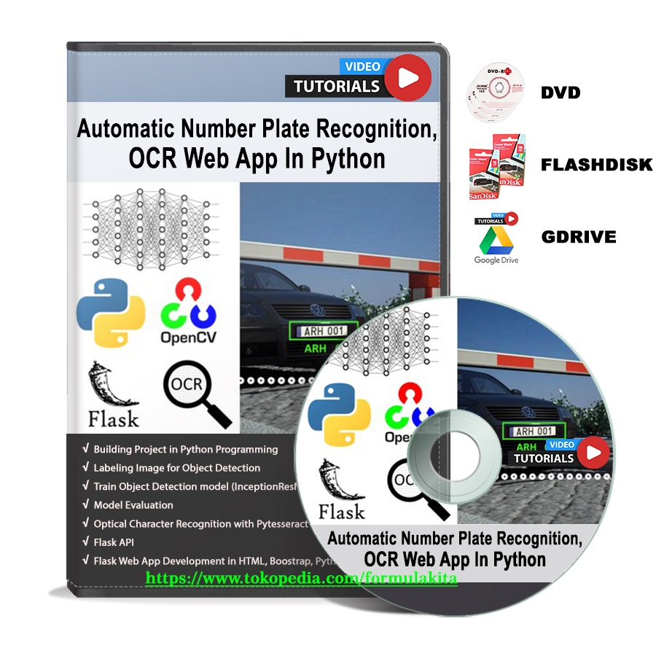
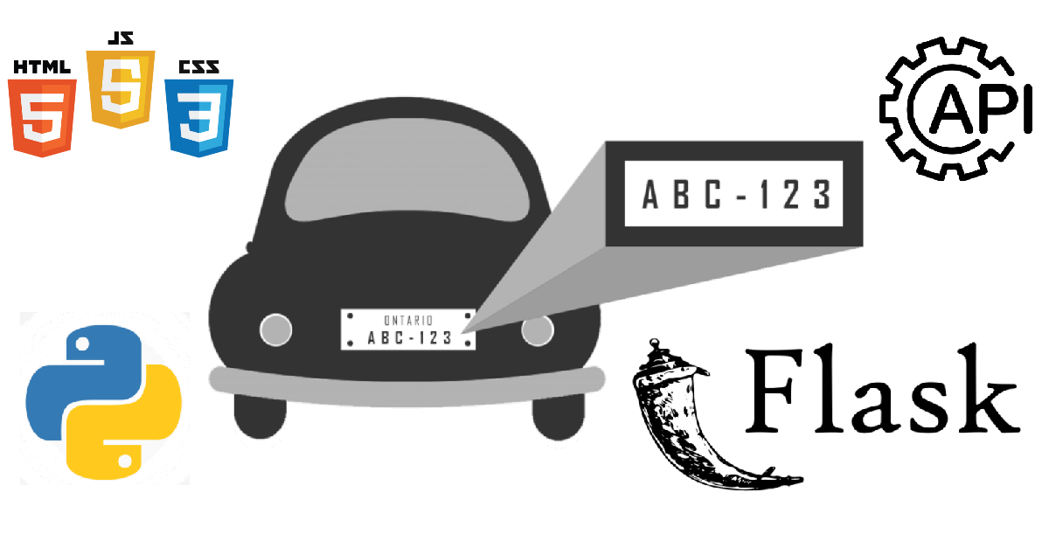
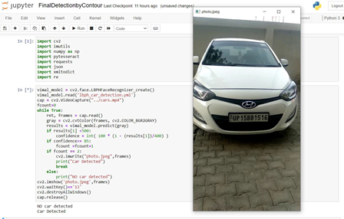
7. NUMBER PLATE WEB APP

Slide 39
7.1 REQUERED TOOLS
All autocomplete
Python extension pack
Yaml
Bootstrap 4, font awesome 4, font awesome 5 free & pro snippets
Django
Html boilerplate
Html snippets
Flask-snippets

Slide 40





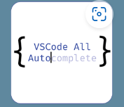

Slide 41




Slide 42

7.2 FLASK APP

Slide 43
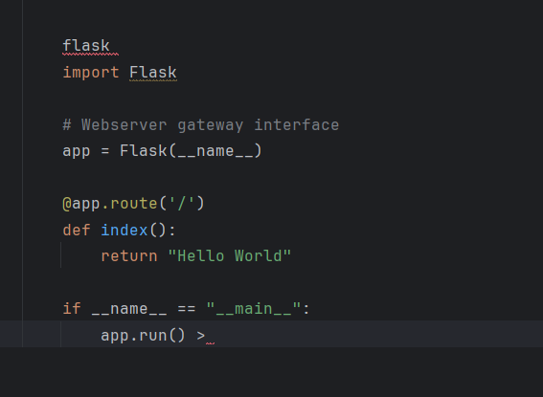

Slide 44
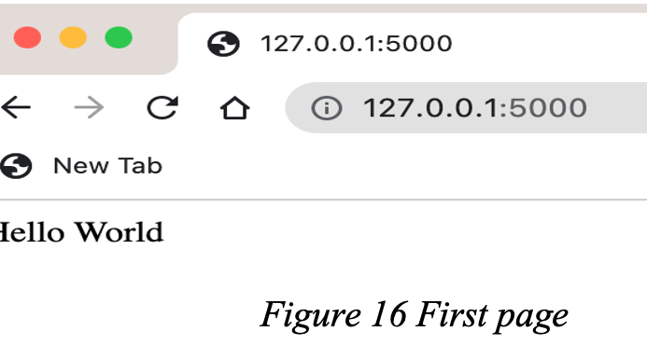

Slide 45
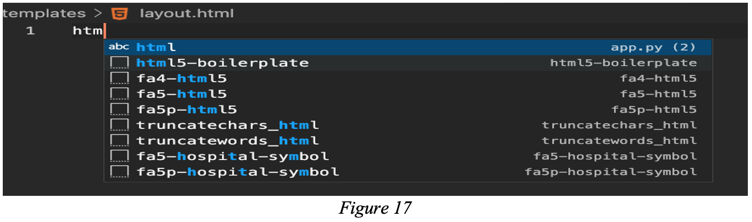

Slide 46
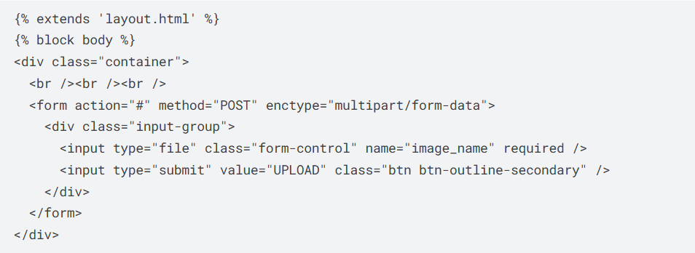

Slide 47
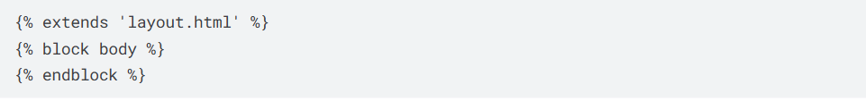

Slide 48
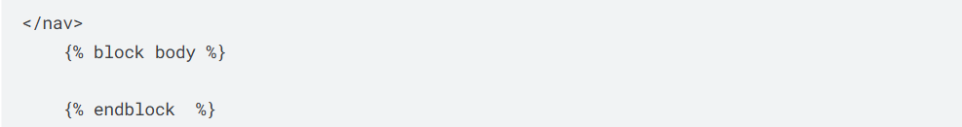

Slide 49
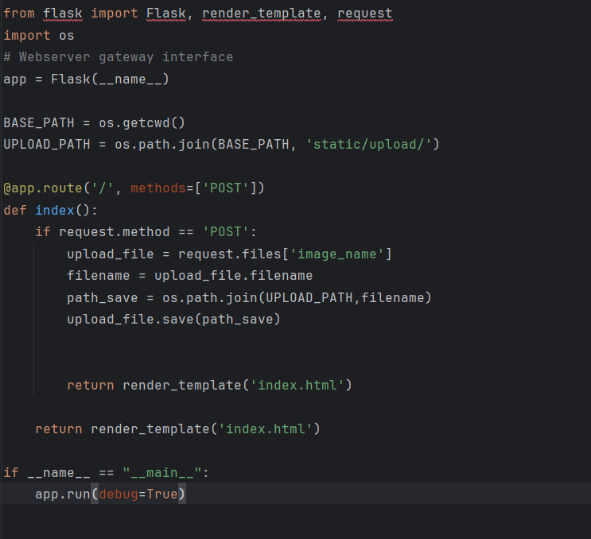

Slide 50

8. RAEAL TIME NUMBER PLATE RECOGNITIONT WITH YOLO

Slide 51
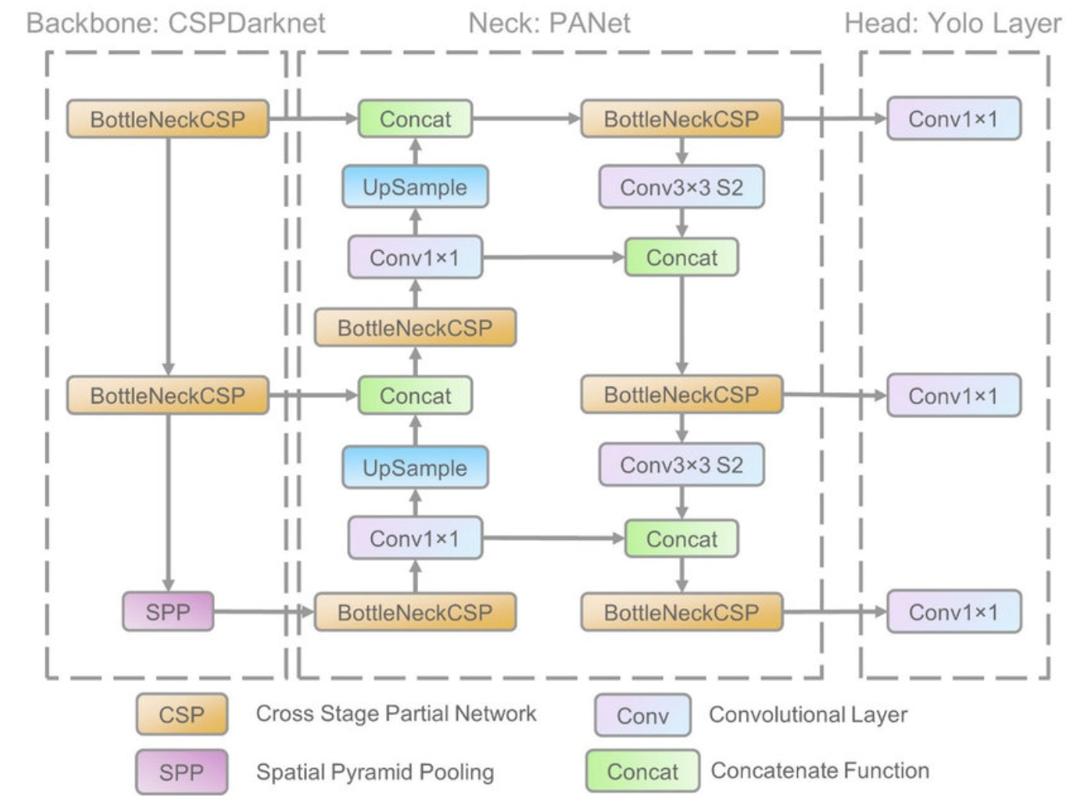
8.1 EXPLANATION OF REQUIRED DATA

Slide 52
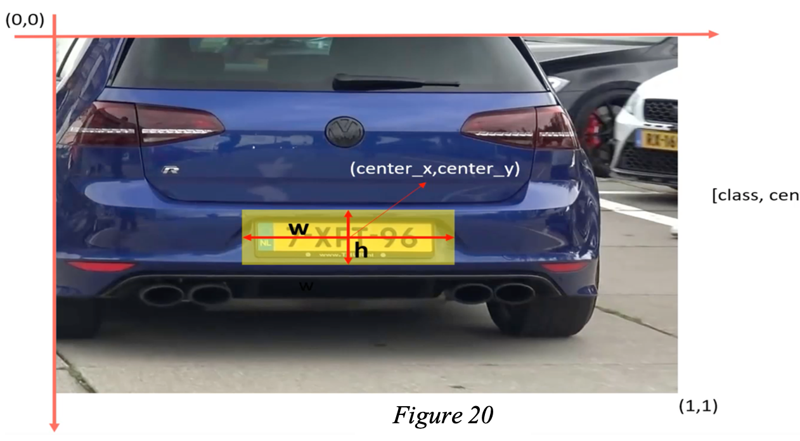

Slide 53


Slide 54

8.2 DATA PREPARATION

Slide 55

8.3 TRAINING YOLO

Slide 56


Slide 57


Slide 58
THANK YOU
Made by team S.O.S

